Slide 1
Among the Pains
Christianity, Disability, Healing
J. Alexander Sider, Ph.D.
Harry and Jean Yoder Scholar in Bible and Religion
Bluffton University

Slide 2
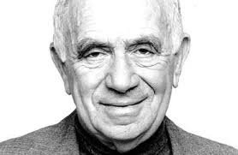

Image credit:
Above: https://media.poetryfoundation.org/m/image/978/yehuda-amichai.jpg?w=1200&h=1200&fit=max.
Right: https://images.gr-assets.com/books/1328874859l/186492.jpg

Slide 3
The Precision of Pain
The precision of pain and the blurriness of joy. I’m thinking
how precise people are when they describe their pain in a doctor’s office.
Even those who haven’t learned to read and write are precise:
“This one’s a throbbing pain, that one’s a wrenching pain,
this one gnaws, that one burns, this is a sharp pain
and that—a dull one. Right here. Precisely here,
yes, yes.” Joy blurs everything. I’ve heard people say
after nights of love and feasting, “It was great,”
I was in seventh heaven.” Even the spaceman who floated
in outer space, tethered to a spaceship, could say only, “Great,
wonderful, I have no words.”
The blurriness of joy and the precision of pain—
I want to describe, with a sharp pain’s precision, happiness
and blurry joy. I learned to speak among the pains.
Yehuda Amichai, Open Closed Open, 99.

Slide 4
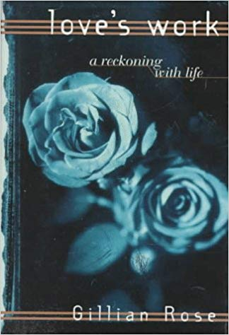
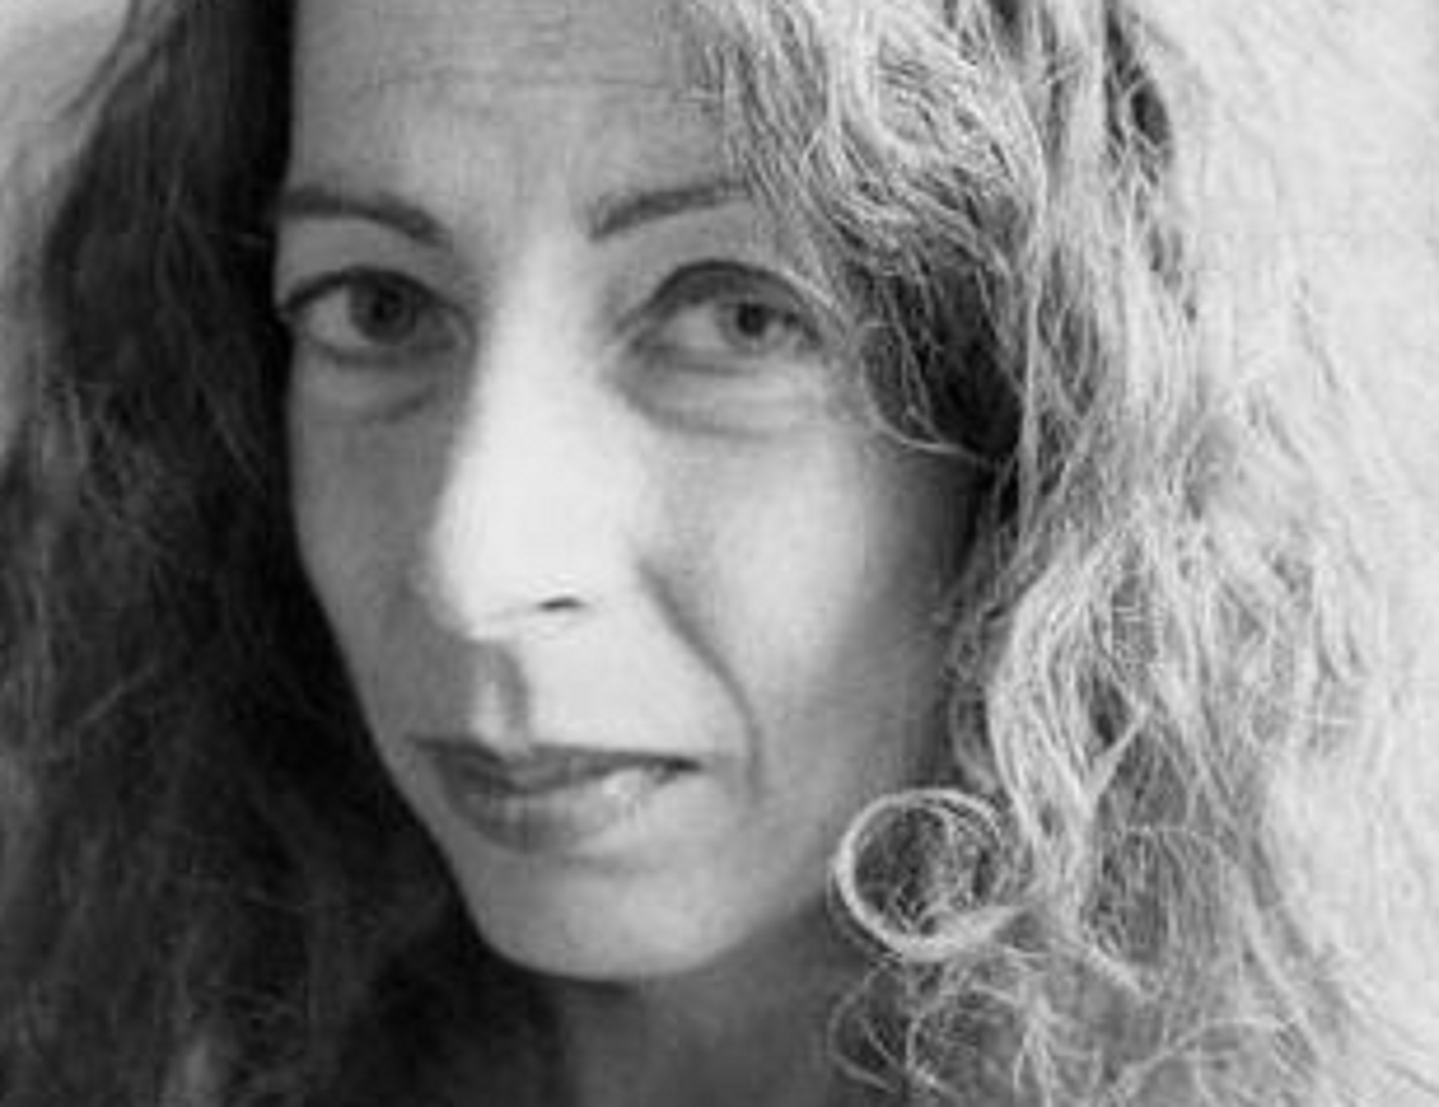
Image Credit:
Above: http://www.unitedagents.co.uk/sites/default/files/thumbnails/image/rosegillian%20photo.jpg
Left: https://images-na.ssl-images-amazon.com/images/I/41EYKC267YL._SX322_BO1,204,203,200_.jpg

Slide 5
“Keep your mind in hell, and despair not.”
--St. Silouan of Athos

Slide 6
Definitions
Impairment, Disability, Medical Model of Disability, Social Model of Disability, Cure, and Healing

Slide 7
Impairment
A diminishment in function or ability when measured against a typical benchmark.
“Any loss or abnormality of psychological, physiological, or anatomical structure or function” (ICIDH definition, 1980).
Condenses several classes of risk: region, race, family medical history, and national origin.
Emerged in life insurance-related efforts “to fix the monetary value of social difference and debility” (Michael Ralph).

Slide 8
Disability
Impairment plus its negative social consequences.
Produced by environmental and social factors as much as by bodily conditions.
No specific set of conditions just is disabling regardless of time, place, and social setting.

Slide 9
“Although people with disabilities span a broad spectrum of medical conditions with diverse effects on appearance and function … whatever the setting, whether in education, medicine, rehabilitation, social welfare policy, or society at large, a common set of stigmatizing values and arrangements has historically operated against us.”
Nancy Eiesland, The Disabled God, 14.

Slide 10
Medical Model of Disability
A set of conditions
Accrues to an individual
Medical community regulates access to services.
Adults with disabilities are four times more likely to report their health to be “fair” or “poor” than people with no disabilities (40.3% vs. 9.9%).
Source: Tawara Goode, “Health Disparities at the Intersection of Race, Ethnicity, and Disability: The Role of Faith Communities.” Lecture. Summer Institute of Theology and Disability. Raleigh, NC: June 12, 2018.

Slide 11
Social Model of Disability
Disability results “from the interactions between persons with impairments and attitudinal and environmental barriers that hinder their full and effective participation in society on an equal basis with others.”
2008 UN Convention on the Rights of Persons with Disabilities

Slide 12
Disability Subjectivity
“While it may be true that to lose one’s leg, or to be visually impaired, or to have a chronic illness in the twenty-first-century United States is incommensurate with what those impairments or conditions meant in eighteenth-century Europe or ancient Egypt, disability itself always begins and ends with the subjective impressions of the individual who experiences the world through her body.”
Adams, Reiss, and Serlin, “Disability,” in Keywords for Disability Studies (New York: NYU Press, 2015), 9.

Slide 13
Cure and Healing
Distinction emerges between U.S. Civil War and WWI as two themes converge:
Christian responses to the “new” medicine.
Critical reflection on the ministry of Jesus.

Slide 14
Ableist theology
Any theology that “presumes able-bodiedness, and by so doing, constructs persons with disabilities as marginalized and largely invisible others.”
Cf. Vera Chouinard, “Making Space for Disabling Difference: Challenging Ableist Geographies,” Environment and Planning D: Society and Space 15:4 (August 1997): 380.

Slide 15
Resources
Dependency, Celebration, and Friendship

Slide 16
Dependency
“Dependence on others allows for needed care, knowledge, culture, technology, and political, social and economic goods.”
Interdependence:
  Combats myth of autonomy and inappropriate dependency, but
  Recasts relationships as reciprocal.
Not “Am I dependent or not?” but “In what ways do I depend on others?”
Source: Eva Feder Kittay, “Dependency” in Keywords for Disability Studies, 54.

Slide 17
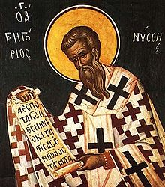
Gregory of Nyssa (335-394 CE)
Did not advocate for interdependence as reciprocity, but for
Mutuality or togetherness as forms of acknowledged dependence based in human relationship to God.

Slide 18
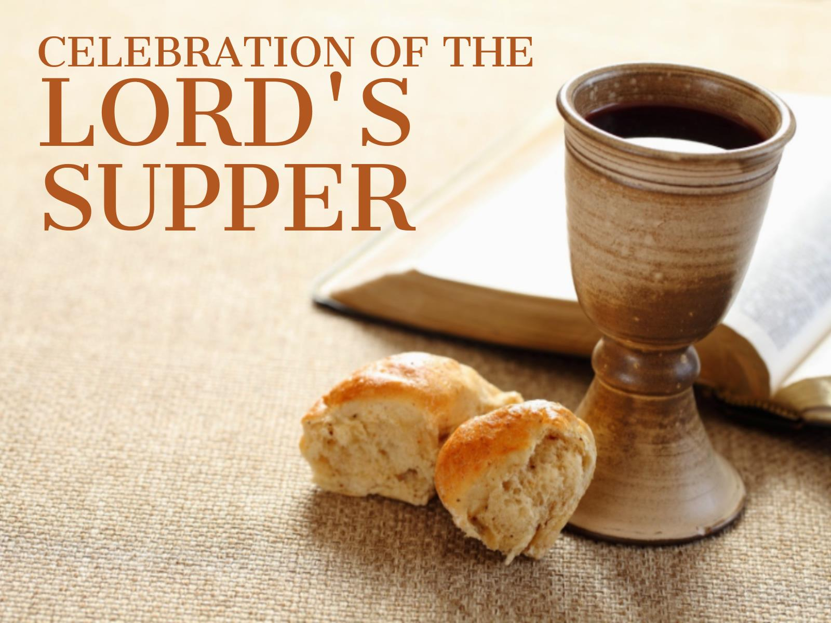
Celebration
“Who celebrates with …?” is a social justice question.
See 1 Corinthians 11:17-22.
Image Credit: http://fbclongwood.org/wp-content/uploads/sites/45/2017/07/Lords-Supper-Monthly.jpg

Slide 19
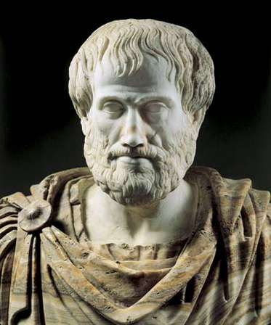
Friendship
Aristotle (384-322 BCE) thought that friendships are usually
Circumstantial or
Convenient,
but that a true friend is like a “second self.”
So: Friendships are matters of similarity.
Image Credit: https://cdn.britannica.com/84/87984-004-5ADE9ACA.jpg

Slide 20
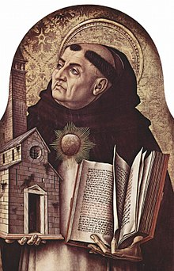
Thomas Aquinas (1225-1274)
We are created to be God’s friends.
Friendship depends on difference, and is a matter of being liked, not a matter of reciprocity.
Image Credit: https://upload.wikimedia.org/wikipedia/commons/thumb/d/d1/Carlo_Crivelli_007.jpg/220px-Carlo_Crivelli_007.jpg

Slide 21
Justice work is never justice work unless it is justice-for-all work.

Slide 22
Bibliography
Adams, Rachel, Benjamin Reiss, and David Serlin, eds. Keywords for Disability Studies. New York: NYU Press, 2015.
Alison, James. On Being Liked. New York: Crossroad, 2003.
Amichai, Yehuda. “The Precision of Pain.” Open Closed Open. Trans. Chana Bloch and Chana Kronfeld. Orlando: Harcourt, 2000.
Chouinard, Vera. “Making Space for Disabling Difference: Challenging Ableist Geographies.” Environment and Planning D: Society and Space 15:4 (August 1997): 379–387.
Eiesland, Nancy L. The Disabled God: Toward a Liberatory Theology of Disability. Nashville: Abingdon Press, 1994.
Endres, David J. “What Medicine Could Not Cure: Faith Healings at the Shrine of Our Lady of Consolation, Carey, Ohio.” U.S. Catholic Historian 34:3 (September 2016): 25-49.
Gaventa, William C. Disability and Spirituality: Recovering Wholeness. Waco, TX: Baylor University Press, 2018.
Goode, Tawara D. “Health Disparities at the Intersection of Race, Ethnicity, and Disability: The Role of Faith Communities.” Lecture. Summer Institute of Theology and Disability. Raleigh, NC: June 12, 2018.
Krahn, G.L., D.K. Walker, and R. Correa-De Araujo. “Persons with Disabilities as an Unrecognized Health Disparity Population.” American Journal of Public Health, 105:Suppl 2 (April 2015): S198-S206. doi: 10.2105/AJPH.2014.302182. Epub February 2015.
MacIntyre, Alasdair. Dependent Rational Animals: Why Humans Need the Virtues. Chicago: Open Court, 1999.
Pochon, R. and C. Declercq. “Emotion Recognition by Children with Down Syndrome: A Longitudinal Study.” Journal of Intellectual and Developmental Disability 38:4 (December 2013): 332-43. doi: 10.3109/13668250.2013.826346.
Rose, Gillian. Love’s Work. London: Chatto & Windus, 1995.
Shanks, Andrew. Against Innocence: Gillian Rose’s Reception and Gift of Faith. London: SCM Press, 2008.
Sider, J. Alexander.To See History Doxologically: History and Holiness in John Howard Yoder’s Ecclesiology. Grand Rapids: Eerdmans, 2011.
Webb-Mitchell, Brett. Beyond Accessibility: Toward the Full Inclusion of People with Disabilities in Faith Communities. New York: Church Publishing, 2010.
Wendell, Susan. “Unhealthy Disabled: Treating Chronic Illnesses as Disabilities.” The Disability Studies Reader. 5 e. Ed. Lennard J. Davis. New York: Routledge, 2017: 160-172.

