Slide 1
Salvation: Therapy, Cure, and Health
Mark 3:9-10; 5:21-43
June 24, 2018
Paul D. Leichty

Slide 2
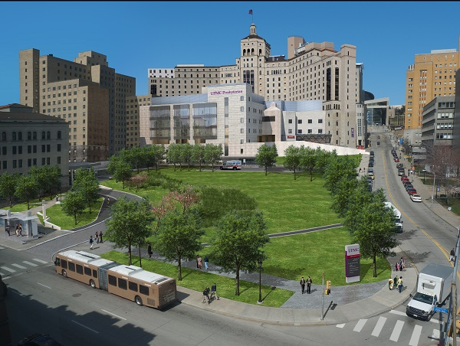
December 2016
Williamsport Regional Medical Center
University of Pittsburgh Medical Center
Presbyterian Hospital

Slide 3
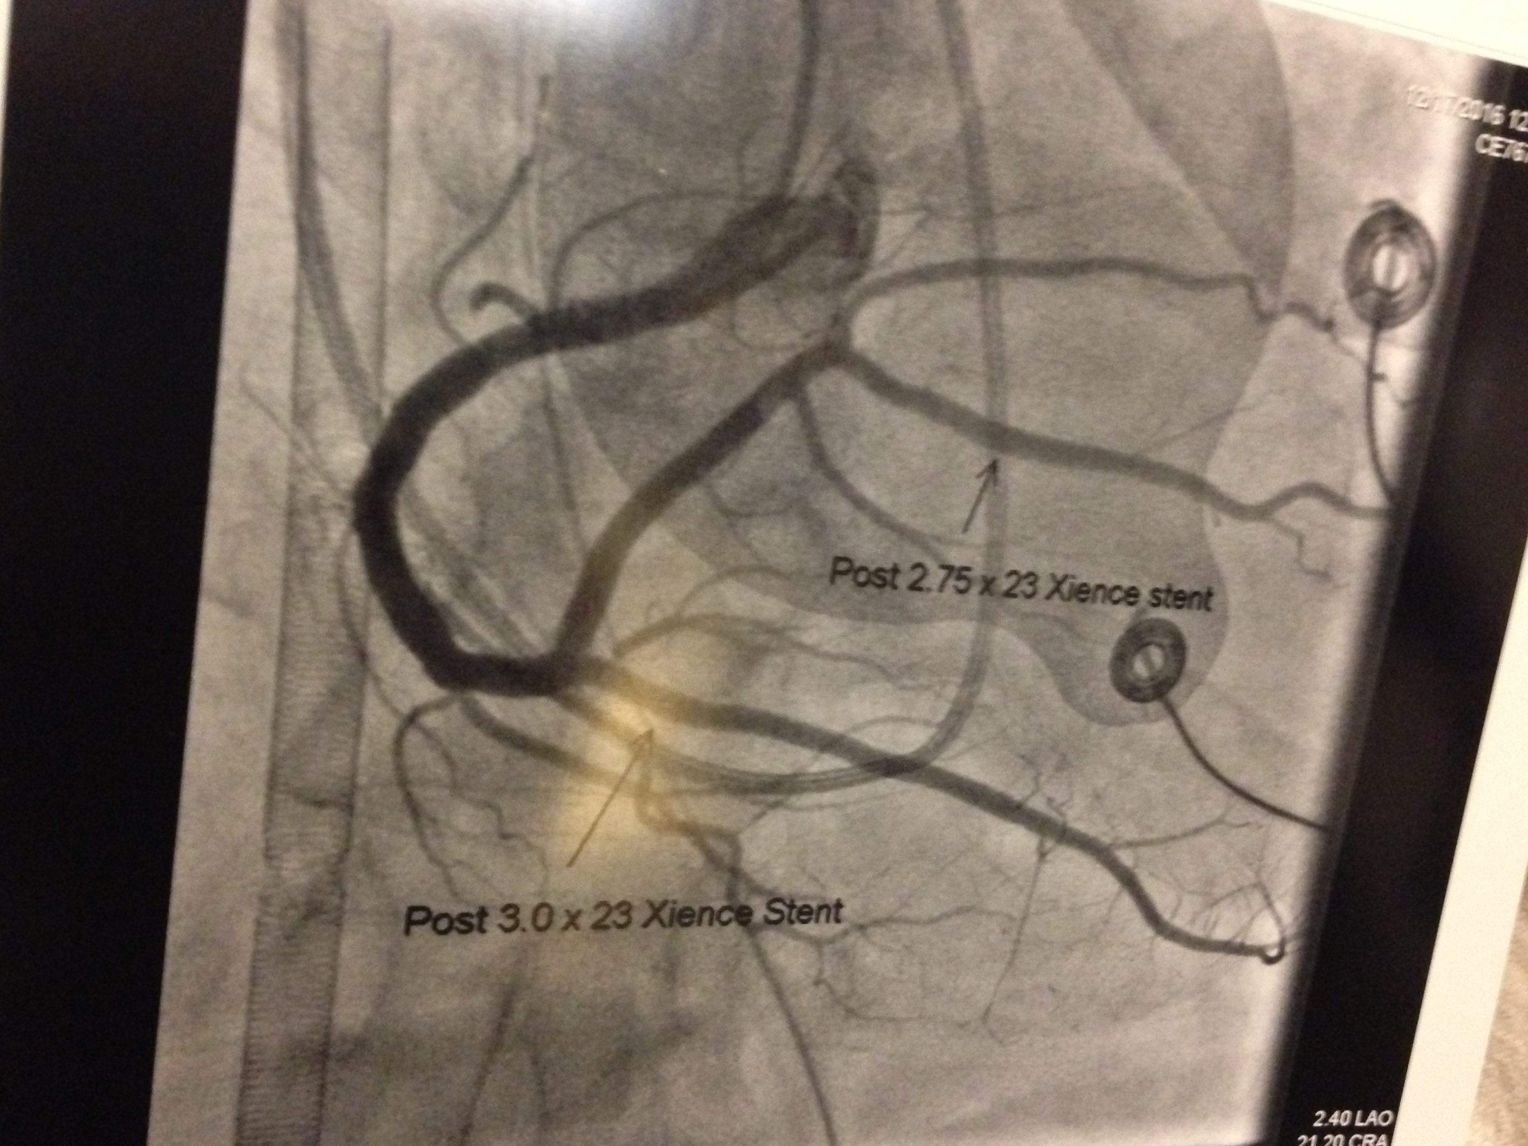
X-ray from Pittsburgh about Dec. 17, 2016
Photo from Pittsburgh about Dec. 20, 2016

Slide 4
Jesus’ healing ministry in Mark’s Gospel
[Jesus] told his disciples to have a boat ready for him because of the crowd, so that they would not crush him; for he had cured many, so that all who had diseases pressed upon him to touch him. Mark 3:9-10

Slide 5
Story within a story – Mark 5:21-43
Jairus’ daughter: ²² Then one of the leaders of the synagogue named Jairus came and, when he saw him, fell at his feet ²³ and begged him repeatedly, “My little daughter is at the point of death. Come and lay your hands on her, so that she may be made well and live.” (NRSV)
Woman with bleeding issue: ²⁵ Now there was a woman who had been suffering from hemorrhages for twelve years…. ²⁷ She had heard about Jesus, and came up behind him in the crowd and touched his cloak, ²⁸ for she said, “If I but touch his clothes, I will be made well.” (NRSV)
³⁸ When they came to the house of the leader of the synagogue, he saw a commotion, people weeping and wailing loudly.

Slide 6
New Testament Greek words for healing
Mark 3:10 | Mark 5:29 | Mark 5:34 | Mark 5:23, 28, 34
θεραπεύω | ἰάομαι | ὑγιής | σώζω
therapeuō | iaomai | hygiēs | sōzō
therapy | iatrogenic | hygiene | soteriology (salvation)
serve, heal, cure | restore, cure, heal, make whole | healthy, well, sound, whole. | rescue, save, make well
Salvation: Therapy, Cure, and Health

Slide 7
Jesus’ healing ministry in Mark’s Gospel
[Jesus] told his disciples to have a boat ready for him because of the crowd, so that they would not crush him; for he had cured many, so that all who had diseases pressed upon him to touch him. Mark 3:9-10
θεραπεύω therapeuō; to wait upon menially, to serve, (figuratively) to adore (God), or (especially) to relieve (of disease): — cure, heal, worship.

Slide 8
Word #1: therapy, service (for healing)
Mark 3:10
θεραπεύω
therapeuō
therapy
serve, heal, cure
Therapy in today’s healthcare system
Jesus had cured many…
Root concept of therapeuô is “to serve.” (New American Standard Exhaustive Concordance of the Bible.)
To give a piece of one’s own life for the life of another.
Therapist = life-giving servant.

Slide 9
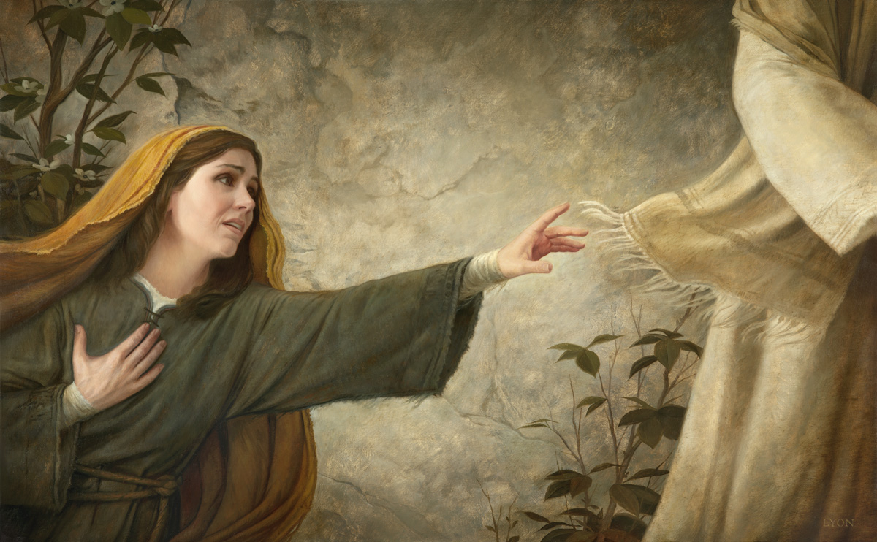
Mark 5:28-29
[The woman] said, “If I but touch his clothes, I will be made well.” ²⁹ Immediately her hemorrhage stopped; and she felt in her body that she was healed of her disease. (NRSV)
[ἰάομαι iaomai]
© Howard Lyon. Used with permission of Howard Lyon Fine Art. www.howardlyon.com

Slide 10
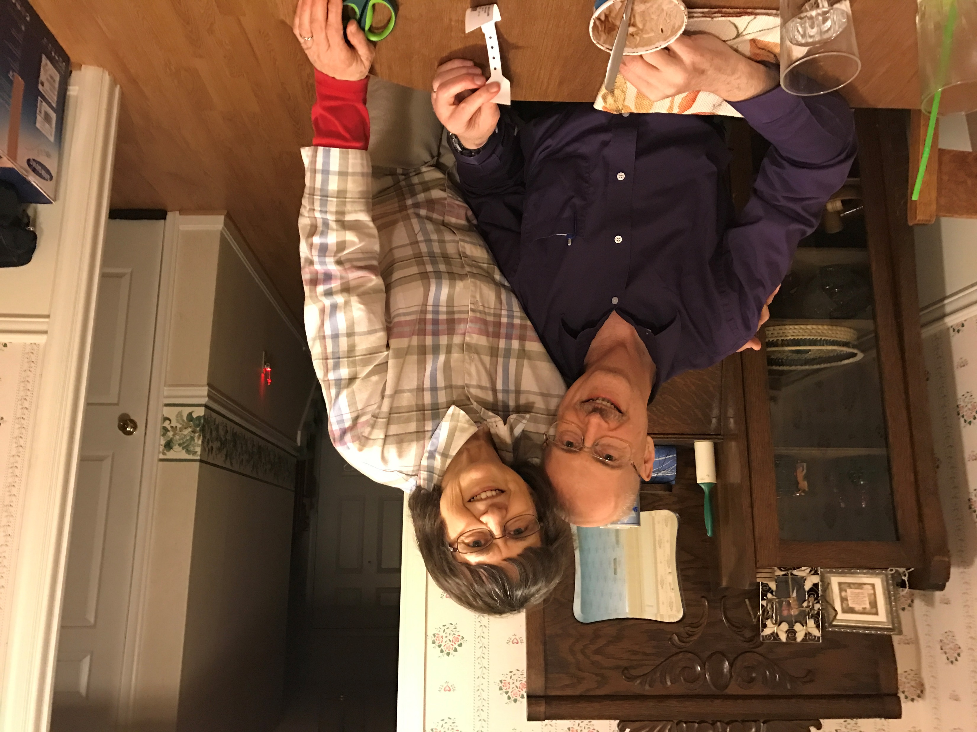
Word #2: Restore, cure
Mark 5:29
ἰάομαι
iaomai
iatrogenic
restore, cure, heal, make whole
[iaomai] means to cure or restore, to bring freedom from the suffering of the disease or condition.
Restore to health = Restore to community

Slide 11
Mark 5:34
[Jesus] said to her, “Daughter, your faith has made you well; go in peace, and be healed of your disease.”(NRSV)
[ὑγιής hygiēs]
© Howard Lyon. Used with permission of Howard Lyon Fine Art. www.howardlyon.com

Slide 12
Word #3: Health, hygiene
Mark 5:34
ὑγιής
hygiēs
hygiene
healthy, well, sound, whole.
Hygienics - “the science that deals with the promotion and preservation of health.”
The health of the community
Jesus says, “…go in peace, and be healed of your disease.”
Greek eirēnē = Hebrew שָׁלוֹם šâlôm shalom
Shalom is a state of health in the sense of body, mind, spirit, relationships

Slide 13
Mark 5:34
[Jesus] said to her, “Daughter, your faith has made you well; go in peace, and be healed of your disease.”(NRSV)
© Howard Lyon. Used with permission of Howard Lyon Fine Art. www.howardlyon.com

Slide 14
New Testament Greek words for healing
Mark 3:10 | Mark 5:29 | Mark 5:34 | ??
θεραπεύω | ἰάομαι | ὑγιής
therapeuō | iaomai | hygiēs
therapy | iatrogenic | hygiene
serve, heal, cure | restore, cure, heal, make whole | healthy, well, sound, whole.

Slide 15
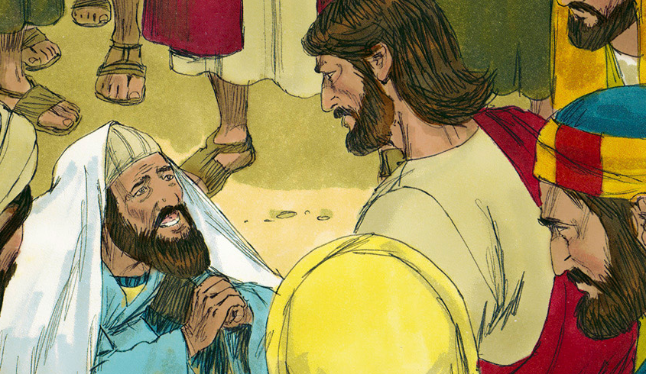
Mark 5:22-23
Then one of the leaders of the synagogue named Jairus came and, when he saw him, fell at his feet and begged him repeatedly, “My little daughter is at the point of death. Come and lay your hands on her, so that she may be made well, and live.” (NRSV)
[σώζω sōzō]

Slide 16
Mark 5:28, 34
[S]he said, “If I but touch his clothes, I will be made well.”
[Jesus] said to her, “Daughter, your faith has made you well; go in peace, and be healed of your disease.”(NRSV)
[σώζω sōzō]
© Howard Lyon. Used with permission of Howard Lyon Fine Art. www.howardlyon.com

Slide 17
Word #4: Salvation
Mark 5:23, 28, 34
σώζω
sōzō
soteriology (salvation)
rescue, save, make well
Word sōzō most often translated “save” or “salvation.”
"Believe on the Lord Jesus, and you will be saved. Acts 16:31 (NRSV)
Jesus says, “For those who want to save their life will lose it, and those who lose their life for my sake, and for the sake of the gospel, will save it.” Mark 8:35 (NRSV)
Healing stories show Jesus as one who saves from all human conditions of sin—anything that destroys or disrupts the shalom in which God intended us to live.

Slide 18
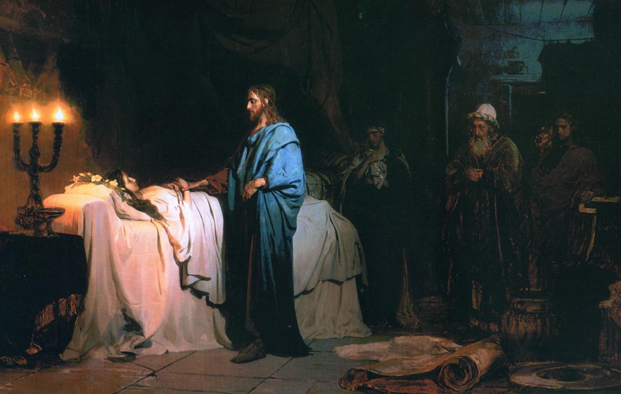
Mark 5:35-36
While he was still speaking, some people came from the leader’s house to say, “Your daughter is dead. Why trouble the teacher any further?” But overhearing what they said, Jesus said to the leader of the synagogue, “Do not fear, only believe.” (NRSV)

Slide 19
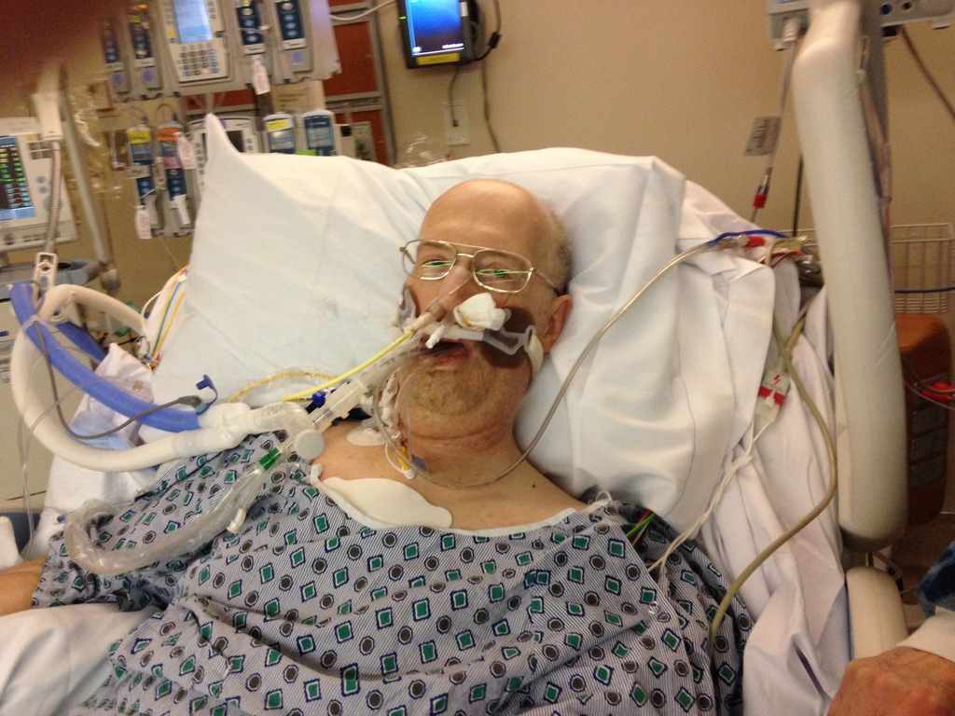
December 15-16, 2016
Williamsport Regional Medical Center
University of Pittsburgh Medical Center
Presbyterian Hospital
I am being flown by helicopter to Pittsburgh.
I’m feeling shocks.
I’m praying, “My times are in your hand…"

Slide 20
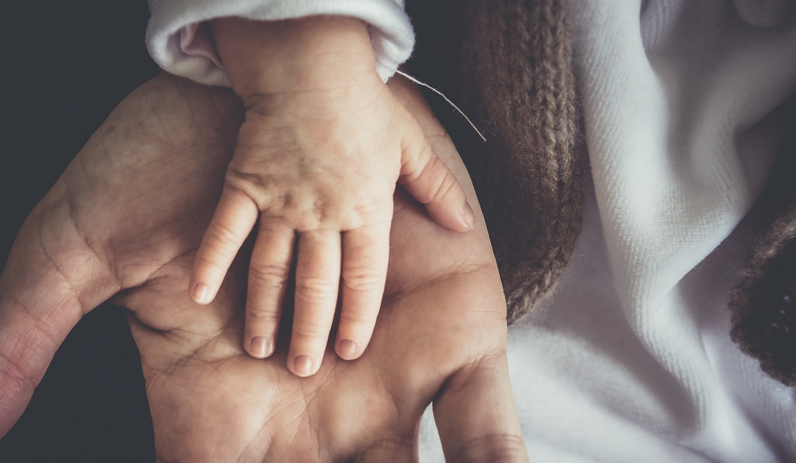
Psalm 31
Into your hand I commit my spirit; you have redeemed me, O Lord, faithful God. Psalms 31:5 (NRSV)
My times are in your hand; deliver me from the hand of my enemies and persecutors. Let your face shine upon your servant; save me in your steadfast love. Psalms 31:15-16 (NRSV)

Slide 21
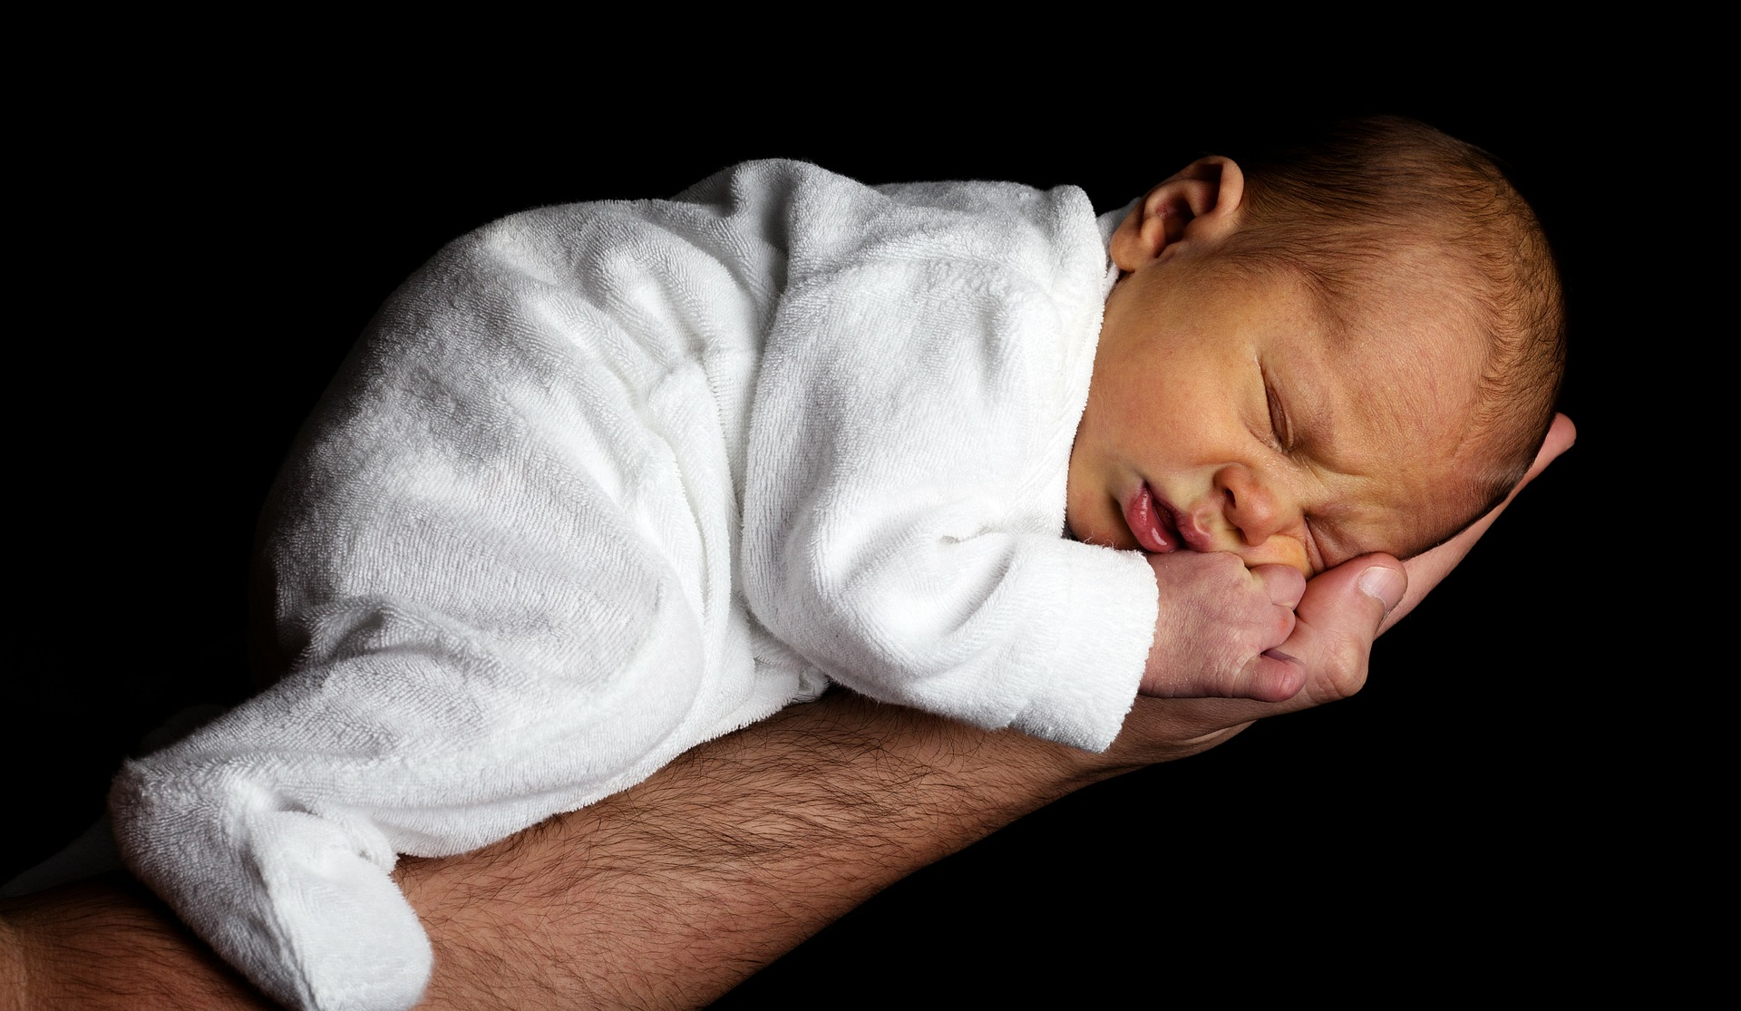
Psalm 31
Into your hand I commit my spirit; you have redeemed me, O Lord, faithful God. Psalms 31:5 (NRSV)
My times are in your hand; deliver me from the hand of my enemies and persecutors. Let your face shine upon your servant; save me in your steadfast love. Psalms 31:15-16 (NRSV)

Slide 22
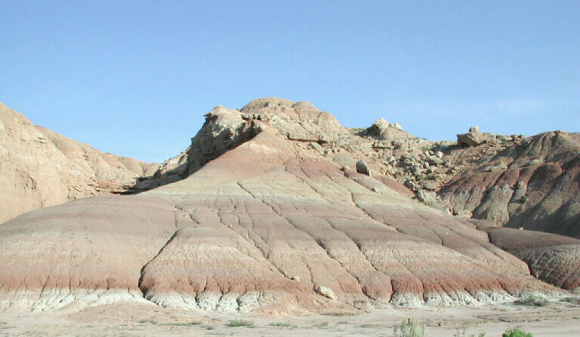
Psalm 31
Be a rock of refuge for me, a strong fortress to save me. Psalms 31:2 (NRSV)

Slide 23
New Testament Greek words for healing
Therapy | Cure | Health | Salvation
Mark 3:10 | Mark 5:29 | Mark 5:34 | Mark 5:23, 28, 34
θεραπεύω | ἰάομαι | ὑγιής | σώζω
therapeuō | iaomai | hygiēs | sōzō
therapy | iatrogenic | hygiene | soteriology (salvation)
serve, heal, cure | restore, cure, heal, make whole | healthy, well, sound, whole. | rescue, save, make well

Slide 24
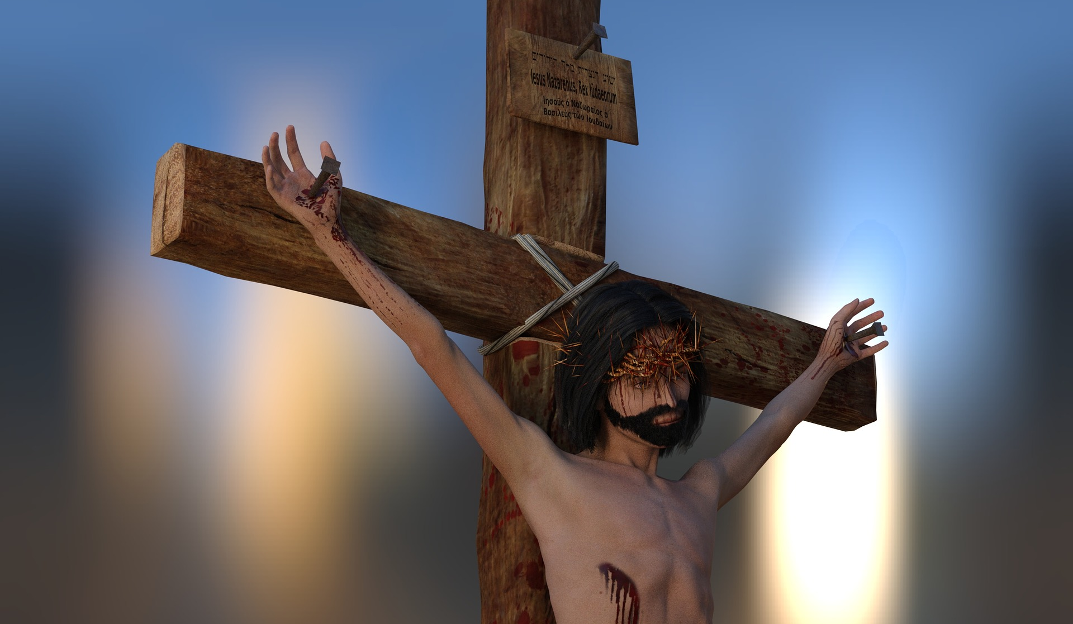
Luke 23:46
⁴⁶Then Jesus, crying with a loud voice, said, “Father, into your hands I commend my spirit.” Having said this, he breathed his last. (NRSV)

Slide 25
New Testament Greek words for healing
Therapy | Cure | Health | Salvation
Mark 3:10 | Mark 5:29 | Mark 5:34 | Mark 5:23, 28, 34
θεραπεύω | ἰάομαι | ὑγιής | σώζω
therapeuō | iaomai | hygiēs | sōzō
therapy | iatrogenic | hygiene | soteriology (salvation)
serve, heal, cure | restore, cure, heal, make whole | healthy, well, sound, whole. | rescue, save, make well
Salvation: Therapy, Cure, and Health

Slide 26
Salvation: Therapy, Cure, and Health
Mark 3:9-10; 5:21-43
June 24, 2018
Paul D. Leichty

Slide 28
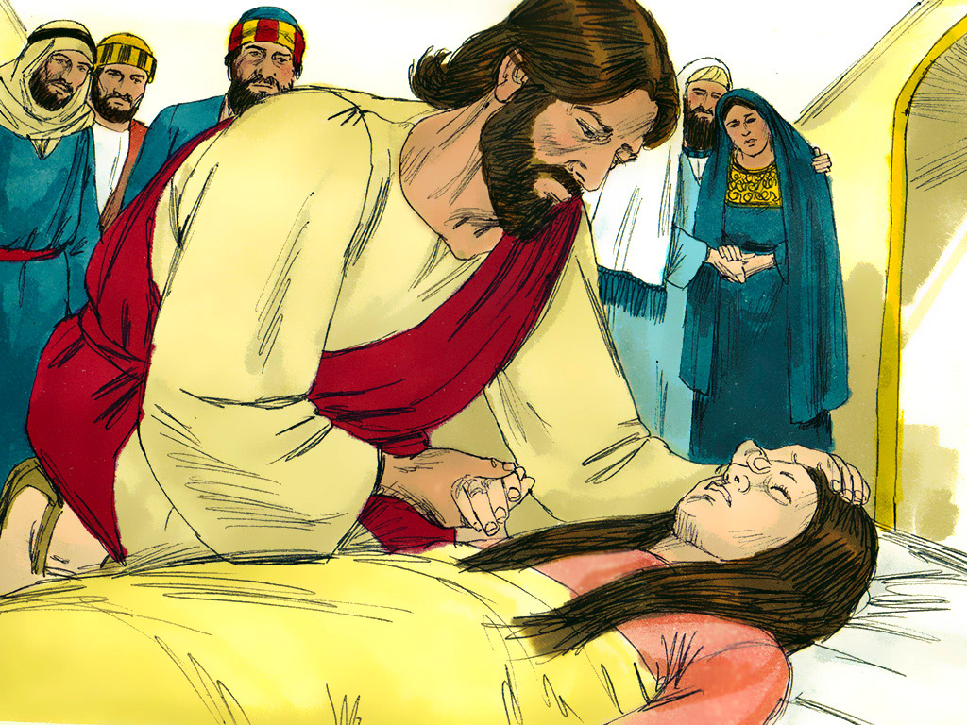
Mark 5:35-36
While he was still speaking, some people came from the leader’s house to say, “Your daughter is dead. Why trouble the teacher any further?” But overhearing what they said, Jesus said to the leader of the synagogue, “Do not fear, only believe.” (NRSV)

